Slide 1
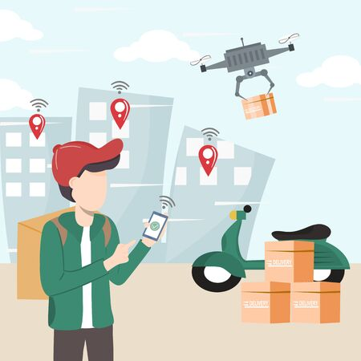
Drone Delivery Case Study

Slide 2

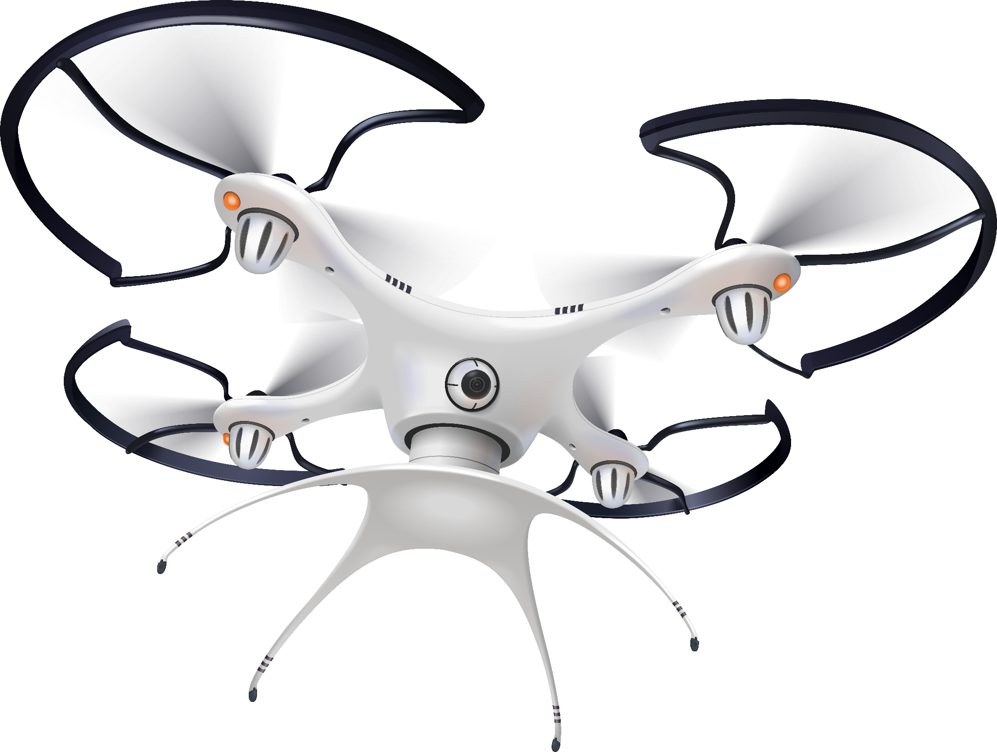
Table of contents
01.
02.
05.
07.
Analysis for Drone Delivery System
Current / Drone Delivery Process
03.
Spot light
04.
Drone Specifications & costs
Cost Analysis
06.
Revenue Forecast
Risk Factors
08.
Conclusion

Slide 3
Analysis for Drone Delivery System
Objective:
Reduce delivery time of orders
Deliver orders for long distance customers
Eventually to raise market growth rate
Scope:
Drone delivery system can be suitable majorly in metropolitan cities

Slide 4


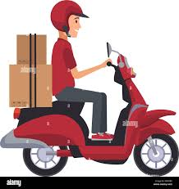
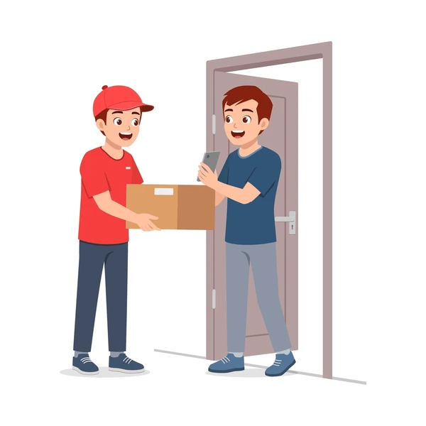
Current Delivery Process
Customer places orders from mobile/website
Restaurants prepares the food
Delivery boy picks-up order from restaurant
And deliveries to customer address

Slide 5
Drone Delivery Process
Customer orders the order from Application/website
Restaurant prepares the food
Delivery boy picks the order from restaurant and hand it over to near by HUB-H1
From HUB-H1 a drone will picks-up the order and handovers to the near by HUB-H2 of customer’s locality
From HUB-H2 another delivery boy will picks up the order and deliveries to customer by bike.

Slide 6
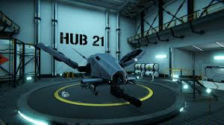
Drone Delivery Process

Slide 7
Spot light
Where a hub is installed at every 4 kms radius of the business restaurants
We can observe the delivery process and delivery time for 16kms distance can be delivered with in 62mins
Delivery process | Radius kms | Time in Minutes
Food Preparation |  | 20
Delivery boy (Restaurant to near by Hub-H1) | 4 | 15
Drone (From Hub-H1 to Hub-H2) | 8 | 12
Delivery boy (Hub-2 to Customer) | 4 | 15
Average Delivery time for 16Kms distant customer | 16 Kms | 62 Mins

Slide 8
Drone Specifications & costs
Autonomous Flight Features
Outdoor Navigation Systems
GPS & Visual Sensing
Max Carrying Capacity :5Kgs
Top Speed: 50kph
3 Direction Obstacle Sensing
Return to home feature
150-300 ft flying altitude
Flying range: 7-8km
40 Kmph Average Speed
Flight time: 30 minutes
INR 130K Cost per Drone
INR 6.5K Maintenance Cost/month
INR 13K Cost per battery
3 months Avg. Battery life

Slide 9
Cost Analysis
Analysing the expenses of Delivery boys salary, bonus per year
Analyzing the expenses of Drones cost, maintenance, per year
Delivery Boy(DB) cost analysis | Amount in RS
1 successful order -Bonus amount | 55
DB salary | 4000
No of avg orders delivered in a month by 1 DB | 450
1 DB salary + bonus per month | 28750
1 DB salary + bonus per year | 345000
Drones cost analysis | Amount in RS
Cost per Drone | 1,30,000
Maintenance cost per month per drone | 6500
Maintenance cost per year per drone | 78000
Cost per battery per Drone | 13000
Cost per battery per year per drone | 52000

Slide 10
Revenue Forecast
Forecasting for next 10 years - yearly revenue in Billions & revenue per order cost in rupees

Slide 11
Risk Factors
Technical Failures
Adverse Weather conditions (In a year 100-120 days, it rains in Hyderabad)
Security Issue
Conclusion
Post analysing the multiple factors on Drone delivery process w.r.t possible risk factors, expenses & maintenance of drones.
Order delivery via drone is a profitable & efficient method with significant benefits of reduced delivery time and enhanced service efficiency.

